Slide 1
Exodus 34:27-35
2 Corinthians 3:1-18

Slide 2
²⁷ And the Lord said to Moses, “Write these words, for in accordance with these words I have made a covenant with you and with Israel.” ²⁸ So he was there with the Lord forty days and forty nights. He neither ate bread nor drank water. And he wrote on the tablets the words of the covenant, the Ten Commandments.
²⁹ When Moses came down from Mount Sinai, with the two tablets of the testimony in his hand as he came down from the mountain, Moses did not know that the skin of his face shone because he had been talking with God. ³⁰ Aaron and all the people of Israel saw Moses, and behold, the skin of his face shone, and they were afraid to come near him. ³¹ But Moses called to them, and Aaron and all the leaders of the congregation returned to him, and Moses talked with them.

Slide 3
³² Afterward all the people of Israel came near, and he commanded them all that the Lord had spoken with him in Mount Sinai. ³³ And when Moses had finished speaking with them, he put a veil over his face.
³⁴ Whenever Moses went in before the Lord to speak with him, he would remove the veil, until he came out. And when he came out and told the people of Israel what he was commanded, ³⁵ the people of Israel would see the face of Moses, that the skin of Moses’ face was shining. And Moses would put the veil over his face again, until he went in to speak with him.

Slide 4
Exodus 34:27-35
2 Corinthians 3:1-18

Slide 5
3 Are we beginning to commend ourselves again? Or do we need, as some do, letters of recommendation to you, or from you? ² You yourselves are our letter of recommendation, written on our hearts, to be known and read by all. ³ And you show that you are a letter from Christ delivered by us, written not with ink but with the Spirit of the living God, not on tablets of stone but on tablets of human hearts.
⁴ Such is the confidence that we have through Christ toward God. ⁵ Not that we are sufficient in ourselves to claim anything as coming from us, but our sufficiency is from God, ⁶ who has made us sufficient to be ministers of a new covenant, not of the letter but of the Spirit. For the letter kills, but the Spirit gives life.

Slide 6
⁷ Now if the ministry of death, carved in letters on stone, came with such glory that the Israelites could not gaze at Moses’ face because of its glory, which was being brought to an end, ⁸ will not the ministry of the Spirit have even more glory? ⁹ For if there was glory in the ministry of condemnation, the ministry of righteousness must far exceed it in glory. ¹⁰ Indeed, in this case, what once had glory has come to have no glory at all, because of the glory that surpasses it. ¹¹ For if what was being brought to an end came with glory, much more will what is permanent have glory.

Slide 7
¹² Since we have such a hope, we are very bold, ¹³ not like Moses, who would put a veil over his face so that the Israelites might not gaze at the outcome of what was being brought to an end. ¹⁴ But their minds were hardened. For to this day, when they read the old covenant, that same veil remains unlifted, because only through Christ is it taken away. ¹⁵ Yes, to this day whenever Moses is read a veil lies over their hearts. ¹⁶ But when one turns to the Lord, the veil is removed. ¹⁷ Now the Lord is the Spirit, and where the Spirit of the Lord is, there is freedom. ¹⁸ And we all, with unveiled face, beholding the glory of the Lord, are being transformed into the same image from one degree of glory to another. For this comes from the Lord who is the Spirit.

Slide 8
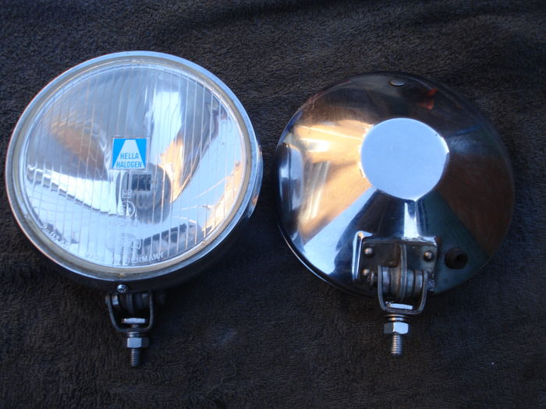





Slide 9
When Moses received ‘The Law’, it was glorious
The Old Covenant enabled fellowship between sinful humans & a Holy God
The Old Covenant is faded compared to the glorious New Covenant in Christ
The Law revealed God’s standard. – how to be holy
  The Glory of God luminated Moses’ face.
  Moses veiled his face so Israel didn’t observe the fading glory
  Symbolic that the Law would also fade in glory
  Words written in stone & ink on paper
  Identifies the human predicament; Condemns; Sin punishable by death
^{Jeremiah 17:9} The heart is deceitful above all things, and desperately sick; who can understand it?
The New Covenant in Christ
Jesus fulfilled the Old Covenant (fulfilled the requirement of the Law)
  The Law is written by the Spirit on our hearts
⁹ For if there was glory in the ministry of condemnation, the ministry of righteousness must far exceed it in glory.

Slide 10
The Old Covenant enabled fellowship between sinful humans & a Holy God
The Old Covenant is faded compared to the glorious New Covenant in Christ
The Law revealed God’s standard. – how to be holy
  The Glory of God luminated Moses’ face.
  Moses veiled his face so Israel didn’t observe the fading glory
  Symbolic that the Law would also fade in glory
  Words written in stone & ink on paper
  Identifies the human predicament; Condemns; Sin punishable by death
The New Covenant – through Christ, we are made righteous before God
Jesus fulfilled the Old Covenant (fulfilled the requirement of the Law)
  The Law is written by the Spirit on our hearts
  To be ‘free’ from sin, takes a profound transformation of a person
The Law lets us know we need a saviour. Jesus is that Saviour
¹⁴ But their minds were hardened. For to this day, when they read the old covenant, that same veil remains unlifted, because only through Christ is it taken away. ¹⁵ Yes, to this day whenever Moses is read a veil lies over their hearts. ¹⁶ But when one turns to the Lord, the veil is removed.

Slide 11
The Old Covenant enabled fellowship between sinful humans & a Holy God
The Old Covenant is faded compared to the glorious New Covenant in Christ
The Law revealed God’s standard. – how to be holy
  The Glory of God luminated Moses’ face.
  Moses veiled his face so Israel didn’t observe the fading glory
  Symbolic that the Law would also fade in glory
  Words written in stone & ink on paper
  Identifies the human predicament; Condemns; Sin punishable by death
The New Covenant – through Christ, we are made righteous before God
Jesus fulfilled the Old Covenant (fulfilled the requirement of the Law)
  The Law is written by the Spirit on our hearts
  To be ‘free’ from sin, takes a profound transformation of a person
The Law lets us know we need a saviour. Jesus is that Saviour
As the Holy Spirit lives in us, we are ever-increasing in Glory
¹⁸ And we all, with unveiled face, beholding the glory of the Lord, are being transformed into the same image from one degree of glory to another…..
A glorious transformation, is a transformed life – to become righteous

